Slide 1
Exercise session 4
Week 5

Slide 2
Exercise 1 — Cadmium metabolism in an agricultural enterprise
An agricultural enterprise involves the processes of cultivation, which includes the vegetation itself, livestock production, and soil. To feed the livestock, the farmer uses both imported and internal fodder (1 and 15 gCd/y respectively). The products from the livestock (milk and meat) have a cadmium content of 2 gCd/y and are sold on the local market. The manure is used to fertilise the crops. The cadmium fallout from the atmosphere to the crops represents 30 gCd/y. The farmer also uses artificial fertiliser with a cadmium content of 5 gCd/y for the cultivation. We assume that all these cadmium inputs are assimilated by the vegetal cover and the concentration in the harvest is 17 gCd/y. Part of it is sold to the local market (2 gCd/y) and the rest is used as fodder. All the crop by–products decompose on the land to feed the soil. There is some erosion and run–off happening, which takes out 2 gCd/y from the soil into the water.
* within / beyond system boundaries (agricultural enterprise)
Draw the system as a quantitative flow chart and calculate the missing flows, as well as the stocks in the system.

Slide 3
Exercise 1 — Cadmium metabolism in an agricultural enterprise
An agricultural enterprise involves the processes of cultivation, which includes the vegetation itself, livestock production, and soil. To feed the livestock, the farmer uses both imported and internal fodder (1 and 15 gCd/y respectively). The products from the livestock (milk and meat) have a cadmium content of 2 gCd/y and are sold on the local market. The manure is used to fertilise the crops. The cadmium fallout from the atmosphere to the crops represents 30 gCd/y. The farmer also uses artificial fertiliser with a cadmium content of 5 gCd/y for the cultivation. We assume that all these cadmium inputs are assimilated by the vegetal cover and the concentration in the harvest is 17 gCd/y. Part of it is sold to the local market (2 gCd/y) and the rest is used as fodder. All the crop by–products decompose on the land to feed the soil. There is some erosion and run–off happening, which takes out 2 gCd/y from the soil into the water.
* within / beyond system boundaries (agricultural enterprise)
Cultivation
Soil
Livestock production
Agricultural enterprise

Slide 4
Exercise 1 — Cadmium metabolism in an agricultural enterprise
An agricultural enterprise involves the processes of cultivation, which includes the vegetation itself, livestock production, and soil. To feed the livestock, the farmer uses both imported and internal fodder (1 and 15 gCd/y respectively). The products from the livestock (milk and meat) have a cadmium content of 2 gCd/y and are sold on the local market. The manure is used to fertilise the crops. The cadmium fallout from the atmosphere to the crops represents 30 gCd/y. The farmer also uses artificial fertiliser with a cadmium content of 5 gCd/y for the cultivation. We assume that all these cadmium inputs are assimilated by the vegetal cover and the concentration in the harvest is 17 gCd/y. Part of it is sold to the local market (2 gCd/y) and the rest is used as fodder. All the crop by–products decompose on the land to feed the soil. There is some erosion and run–off happening, which takes out 2 gCd/y from the soil into the water.
* within / beyond system boundaries (agricultural enterprise)
Cultivation
Soil
15
Imports
Livestock production
1
Agricultural enterprise
Unit: [gCd/y]

Slide 5
Exercise 1 — Cadmium metabolism in an agricultural enterprise
An agricultural enterprise involves the processes of cultivation, which includes the vegetation itself, livestock production, and soil. To feed the livestock, the farmer uses both imported and internal fodder (1 and 15 gCd/y respectively). The products from the livestock (milk and meat) have a cadmium content of 2 gCd/y and are sold on the local market. The manure is used to fertilise the crops. The cadmium fallout from the atmosphere to the crops represents 30 gCd/y. The farmer also uses artificial fertiliser with a cadmium content of 5 gCd/y for the cultivation. We assume that all these cadmium inputs are assimilated by the vegetal cover and the concentration in the harvest is 17 gCd/y. Part of it is sold to the local market (2 gCd/y) and the rest is used as fodder. All the crop by–products decompose on the land to feed the soil. There is some erosion and run–off happening, which takes out 2 gCd/y from the soil into the water.
* within / beyond system boundaries (agricultural enterprise)
Atmosphere
30
Cultivation
Soil
?
15
Imports
Livestock production
Local market
1
2
Agricultural enterprise
Unit: [gCd/y]

Slide 6
Exercise 1 — Cadmium metabolism in an agricultural enterprise
An agricultural enterprise involves the processes of cultivation, which includes the vegetation itself, livestock production, and soil. To feed the livestock, the farmer uses both imported and internal fodder (1 and 15 gCd/y respectively). The products from the livestock (milk and meat) have a cadmium content of 2 gCd/y and are sold on the local market. The manure is used to fertilise the crops. The cadmium fallout from the atmosphere to the crops represents 30 gCd/y. The farmer also uses artificial fertiliser with a cadmium content of 5 gCd/y for the cultivation. We assume that all these cadmium inputs are assimilated by the vegetal cover and the concentration in the harvest is 17 gCd/y. Part of it is sold to the local market (2 gCd/y) and the rest is used as fodder. All the crop by–products decompose on the land to feed the soil. There is some erosion and run–off happening, which takes out 2 gCd/y from the soil into the water.
* within / beyond system boundaries (agricultural enterprise)
Atmosphere
30
Cultivation
Soil
5
?
15
2
Imports
Livestock production
Local market
1
2
Agricultural enterprise
Unit: [gCd/y]

Slide 7
Exercise 1 — Cadmium metabolism in an agricultural enterprise
An agricultural enterprise involves the processes of cultivation, which includes the vegetation itself, livestock production, and soil. To feed the livestock, the farmer uses both imported and internal fodder (1 and 15 gCd/y respectively). The products from the livestock (milk and meat) have a cadmium content of 2 gCd/y and are sold on the local market. The manure is used to fertilise the crops. The cadmium fallout from the atmosphere to the crops represents 30 gCd/y. The farmer also uses artificial fertiliser with a cadmium content of 5 gCd/y for the cultivation. We assume that all these cadmium inputs are assimilated by the vegetal cover and the concentration in the harvest is 17 gCd/y. Part of it is sold to the local market (2 gCd/y) and the rest is used as fodder. All the crop by–products decompose on the land to feed the soil. There is some erosion and run–off happening, which takes out 2 gCd/y from the soil into the water.
* within / beyond system boundaries (agricultural enterprise)
Atmosphere
30
Cultivation
?
Soil
2
Hydrosphere
5
?
15
2
Imports
Livestock production
Local market
1
2
Agricultural enterprise
Unit: [gCd/y]

Slide 8
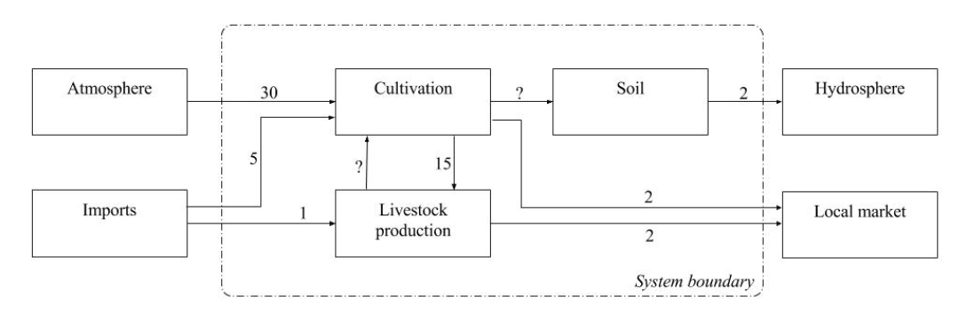
Exercise 1 — Cadmium metabolism in an agricultural enterprise
Draw the system as a quantitative flow chart and calculate the missing flows, as well as the stocks in the system.
Calculate the transfer coefficient of the run–off to water for the entire system.
Suggest measures to make the system steady state. Calculate the change in the transfer coefficients of a system in steady state compared to the current situation. Discuss the applicability of the suggested measures and identify possible side effects.

Slide 9
Exercise 1 — Cadmium metabolism in an agricultural enterprise
Draw the system as a quantitative flow chart and calculate the missing flows, as well as the stocks in the system.
Flow (livestock–cultivation, i.e. manure):
Total input = 1 + 15 = 16
Known output from livestock production = 2
Assuming steady state, manure = 16 - 2 = 14

Slide 10
Exercise 1 — Cadmium metabolism in an agricultural enterprise
Draw the system as a quantitative flow chart and calculate the missing flows, as well as the stocks in the system.
Flow (livestock–cultivation, i.e. manure):
Total input = 1 + 15 = 16
Known output from livestock production = 2
Assuming steady state, manure = 16 - 2 = 14
Flow (cultivation–soil, i.e. decomposition):
Total input = 30 + 5 + 14 = 49
Known outputs from cultivation = 15 + 2 = 17
Assuming steady state, decomposition = 49 - 17 = 32

Slide 11
Exercise 1 — Cadmium metabolism in an agricultural enterprise
Draw the system as a quantitative flow chart and calculate the missing flows, as well as the stocks in the system.
Flow (livestock–cultivation, i.e. manure):
Total input = 1 + 15 = 16
Known output from livestock production = 2
Assuming steady state, manure = 16 - 2 = 14
Flow (cultivation–soil, i.e. decomposition):
Total input = 30 + 5 + 14 = 49
Known outputs from cultivation = 15 + 2 = 17
Assuming steady state, decomposition = 49 - 17 = 32
Stock in soil:
dStock/dt = 32 - 2 = 30

Slide 12
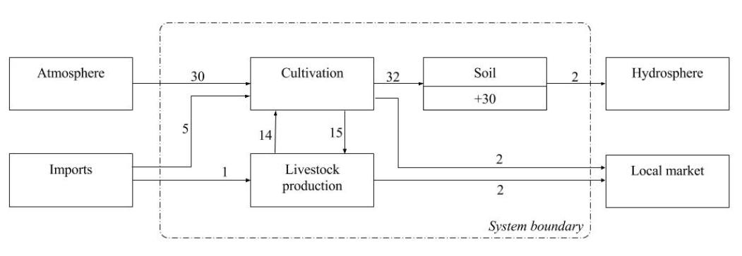

Exercise 1 — Cadmium metabolism in an agricultural enterprise
Draw the system as a quantitative flow chart and calculate the missing flows, as well as the stocks in the system.
Calculate the transfer coefficient of the runoff to water for the entire system.
Suggest measures to make the system steady state. Calculate the change in the transfer coefficients of a system in steady state compared to the current situation. Discuss the applicability of the suggested measures and identify possible side effects.

Slide 13
Exercise 1 — Cadmium metabolism in an agricultural enterprise
Draw the system as a quantitative flow chart and calculate the missing flows, as well as the stocks in the system.
Calculate the transfer coefficient of the runoff to water for the entire system.
Suggest measures to make the system steady state. Calculate the change in the transfer coefficients of a system in steady state compared to the current situation. Discuss the applicability of the suggested measures and identify possible side effects.
Main cadmium input: atmosphere (fallout from anthropogenic sources)
Steady state system = reduction of cadmium input to the soil

Slide 14
Exercise 1 — Cadmium metabolism in an agricultural enterprise
Draw the system as a quantitative flow chart and calculate the missing flows, as well as the stocks in the system.
Calculate the transfer coefficient of the runoff to water for the entire system.
Suggest measures to make the system steady state. Calculate the change in the transfer coefficients of a system in steady state compared to the current situation. Discuss the applicability of the suggested measures and identify possible side effects.
Main cadmium input: atmosphere (fallout from anthropogenic sources)
Steady state system = reduction of cadmium input to the soil
Currently,

Slide 15
Exercise 1 — Cadmium metabolism in an agricultural enterprise
Draw the system as a quantitative flow chart and calculate the missing flows, as well as the stocks in the system.
Calculate the transfer coefficient of the runoff to water for the entire system.
Suggest measures to make the system steady state. Calculate the change in the transfer coefficients of a system in steady state compared to the current situation. Discuss the applicability of the suggested measures and identify possible side effects.
Main cadmium input = atmosphere (fallout from anthropogenic sources)
Steady state system = reduction of cadmium input to the soil
Currently,
Assuming steady state, decomposition = run-off to hydrosphere = 2,

Slide 16
Exercise 1 — Cadmium metabolism in an agricultural enterprise
Draw the system as a quantitative flow chart and calculate the missing flows, as well as the stocks in the system.
Calculate the transfer coefficient of the runoff to water for the entire system.
Suggest measures to make the system steady state. Calculate the change in the transfer coefficients of a system in steady state compared to the current situation. Discuss the applicability of the suggested measures and identify possible side effects.
Main cadmium input = atmosphere (fallout from anthropogenic sources)
Steady state system = reduction of cadmium input to the soil
Currently,
Assuming steady state, decomposition = run-off to hydrosphere = 2,
This would increase Cd concentration in the food chain!
Alternatively, productive chains which use crop-by products could be established

Slide 17
Exercise 2— Metabolism of a gravel pit
Company XYZ operates a gravel pit and performs construction work (building/renovation of buildings) on-site. The current gravel stock in the pit is 1’000’000 tonnes. Gravel is extracted from the pit for sale to external clients (fixed amount of 20’000 tonnes every year), and also for the company’s own construction activities on-site. The empty pit is used to store demolition material (inert) received from external construction companies. The demolition material is ground by Company XYZ and half is used for construction. For its own constructions, Company XYZ uses both the grinded demolition material and extracted gravel from the pit (4 to 1 ratio).
The company is interested to know how much demolition material it can use per year in order to maximise the use of empty space in the gravel pit so as to avoid incurring additional costs for an external landfill.
Set up a system diagram of the company.
Establish the system equations.
Solve the equations and quantify the system diagram.

Slide 18
Exercise 2— Metabolism of a gravel pit
Company XYZ operates a gravel pit and performs construction work on-site (building/renovation of buildings). The current gravel stock in the pit is 1’000’000 tonnes. Gravel is extracted from the pit for sale to external clients (fixed amount of 20’000 tonnes every year), and also for the company’s own construction activities on-site. The empty pit is used to store demolition material (inert) received from external construction companies. The demolition material is ground by Company XYZ before storage and half is used for construction. For its own constructions, Company XYZ uses both the grinded demolition material and extracted gravel from the pit (4 to 1 ratio).
The company is interested to know how much demolition material it can use per year in order to maximise the use of empty space in the gravel pit so as to avoid incurring additional costs for an external landfill.
Gravel pit/construction company

Slide 19
Exercise 2— Metabolism of a gravel pit
Company XYZ operates a gravel pit and performs construction work on-site (building/renovation of buildings). The current gravel stock in the pit is 1’000’000 tonnes. Gravel is extracted from the pit for sale to external clients (fixed amount of 20’000 tonnes every year), and also for the company’s own construction activities on-site. The empty pit is used to store demolition material (inert) received from external construction companies. The demolition material is ground by Company XYZ before storage and half is used for construction. For its own constructions, Company XYZ uses both the grinded demolition material and extracted gravel from the pit (4 to 1 ratio).
The company is interested to know how much demolition material it can use per year in order to maximise the use of empty space in the gravel pit so as to avoid incurring additional costs for an external landfill.
extraction
Gravel pit/construction company
clients

Slide 20
Exercise 2— Metabolism of a gravel pit
Company XYZ operates a gravel pit and performs construction work on-site (building/renovation of buildings). The current gravel stock in the pit is 1’000’000 tonnes. Gravel is extracted from the pit for sale to external clients (fixed amount of 20’000 tonnes every year), and also for the company’s own construction activities on-site. The empty pit is used to store demolition material (inert) received from external construction companies. The demolition material is ground by Company XYZ before storage and half is used for construction. For its own constructions, Company XYZ uses both the grinded demolition material and extracted gravel from the pit (4 to 1 ratio).
The company is interested to know how much demolition material it can use per year in order to maximise the use of empty space in the gravel pit so as to avoid incurring additional costs for an external landfill.
extraction
construction
Gravel pit/construction company
clients

Slide 21
Exercise 2— Metabolism of a gravel pit
Company XYZ operates a gravel pit and performs construction work on-site (building/renovation of buildings). The current gravel stock in the pit is 1’000’000 tonnes. Gravel is extracted from the pit for sale to external clients (fixed amount of 20’000 tonnes every year), and also for the company’s own construction activities on-site. The empty pit is used to store demolition material (inert) received from external construction companies. The demolition material is ground by Company XYZ before storage and half is used for construction. For its own constructions, Company XYZ uses both the grinded demolition material and extracted gravel from the pit (4 to 1 ratio).
The company is interested to know how much demolition material it can use per year in order to maximise the use of empty space in the gravel pit so as to avoid incurring additional costs for an external landfill.
demolition
storage
extraction
construction
Gravel pit/construction company
clients

Slide 22
Exercise 2— Metabolism of a gravel pit
Company XYZ operates a gravel pit and performs construction work on-site (building/renovation of buildings). The current gravel stock in the pit is 1’000’000 tonnes. Gravel is extracted from the pit for sale to external clients (fixed amount of 20’000 tonnes every year), and also for the company’s own construction activities on-site. The empty pit is used to store demolition material (inert) received from external construction companies. The demolition material is ground by Company XYZ before storage and half is used for construction. For its own constructions, Company XYZ uses both the grinded demolition material and extracted gravel from the pit (4 to 1 ratio).
The company is interested to know how much demolition material it can use per year in order to maximise the use of empty space in the gravel pit so as to avoid incurring additional costs for an external landfill.
demolition
grinding
storage
extraction
construction
Gravel pit/construction company
clients

Slide 23
Exercise 2— Metabolism of a gravel pit
Company XYZ operates a gravel pit and performs construction work on-site (building/renovation of buildings). The current gravel stock in the pit is 1’000’000 tonnes. Gravel is extracted from the pit for sale to external clients (fixed amount of 20’000 tonnes every year), and also for the company’s own construction activities on-site. The empty pit is used to store demolition material (inert) received from external construction companies. The demolition material is ground by Company XYZ before storage and half is used for construction. For its own constructions, Company XYZ uses both the grinded demolition material and extracted gravel from the pit (4 to 1 ratio).
The company is interested to know how much demolition material it can use per year in order to maximise the use of empty space in the gravel pit so as to avoid incurring additional costs for an external landfill.
demolition
grinding
storage
extraction
construction
Gravel pit/construction company
clients

Slide 24
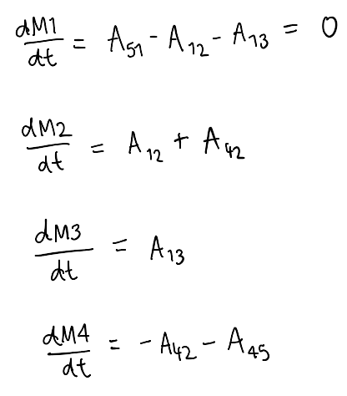
Exercise 2— Metabolism of a gravel pit
Exercise 2— Metabolism of a gravel pit
demolition
Set up a system diagram of the company.
Establish the system equations.
Solve the equations and quantify the system diagram.
(for stocks within system boundaries)
M(5)
A51
grinding
M(1)
storage
A13
M(3)
A12
extraction
construction
M(4)
A42
M(2)
A45
Gravel pit/construction company
clients
M(5)

Slide 25
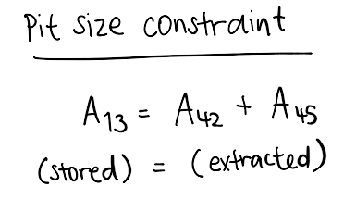
Exercise 2— Metabolism of a gravel pit
Exercise 2— Metabolism of a gravel pit
demolition
Set up a system diagram of the company.
Establish the system equations.
Solve the equations and quantify the system diagram.
(for stocks within system boundaries)
M(5)
A51
grinding
M(1)
storage
A13
M(3)
A12
extraction
construction
M(4)
A42
M(2)
A45
Gravel pit/construction company
clients
M(5)

Slide 26
Exercise 2— Metabolism of a gravel pit
Exercise 2— Metabolism of a gravel pit
Demolition
A51
Grinding
M(5)
M(1)
A12
A13
Construction
Storage
M(2)
M(3)
A42
Gravel extraction
M(4)
A45
Clients
M(5)

